Slide 1
Perceptron

Slide 2
CONTENTS
Neural Network | artificial neural network, architecture,
Logistic Regression | simple description to Logistic Regression
Single Layer Perceptron | AND, OR, NAND
Multiple Layer Perceptron | Ndarray, reshape, dot product, concatenate, split, useful methods
For more info: SLIDESGO | SLIDESGO SCHOOL | FAQs
You can visit our sister projects: FREEPIK | FLATICON | STORYSET | WEPIK | VIDEVO

Slide 3
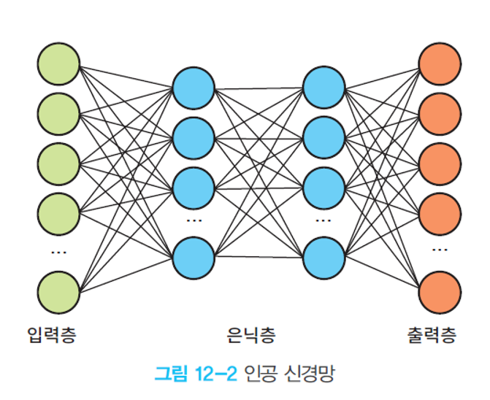
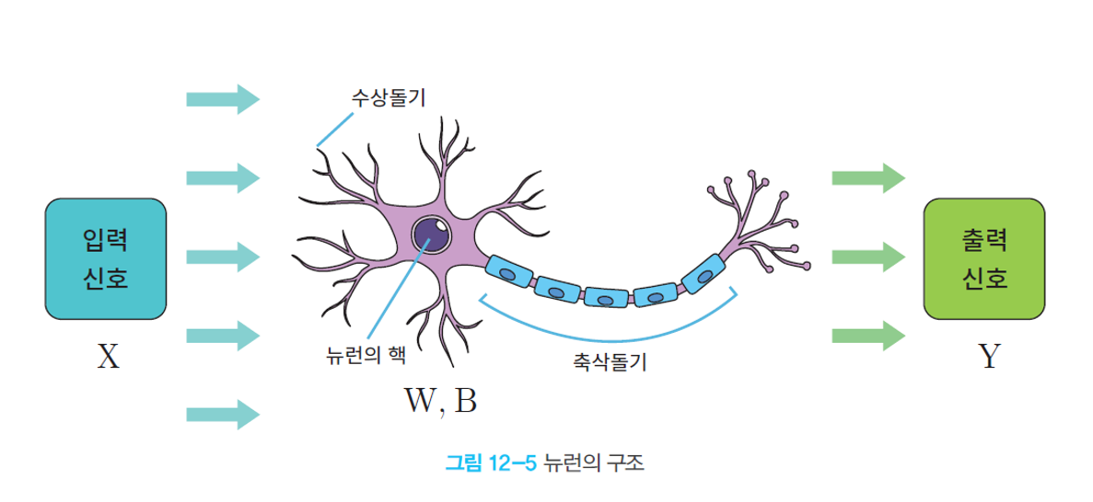
Neural Network
Artificial Neural Network(ANN) is a computing architecture made similar with biological neural network.
Perceptron is an algorithm which gets several input data and results in one output as a unit of ANN.

Slide 4
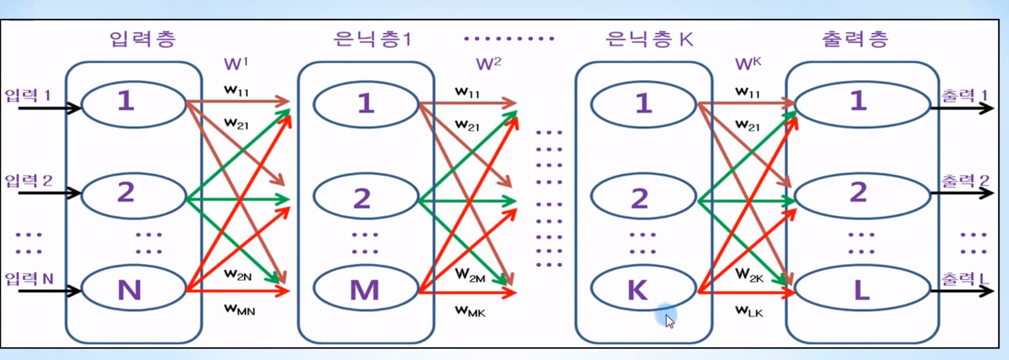
Neural Network
There are three types of layers: input layer, hidden layer, output layer
input layer: a layer which get input data
hidden layer: a layer which does learning
output layer: a layer which output results
: a Node; a logistic regression

Slide 5
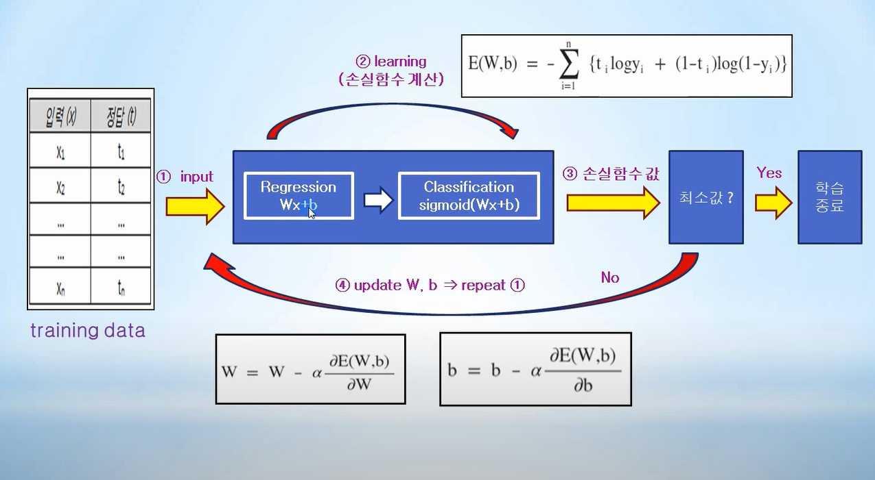
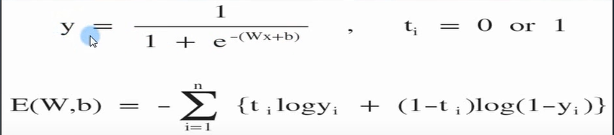
Logistic Regression
Logistic Regression is a classification method which classifies input data into a certain category.

Slide 6
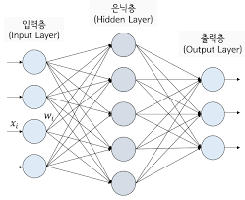
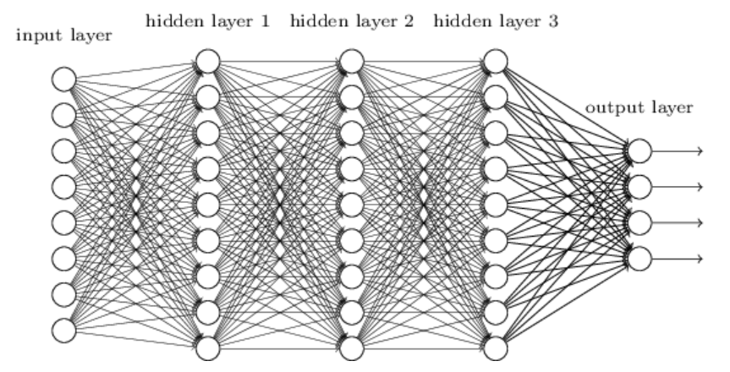
Single Layer Perceptron
Single Layer Perceptron: 1 hidden layer
Multiple Layer Perceptron: more than 1 hidden layer

Slide 7
Single Layer Perceptron
Let's think about AND, OR, NAND logical gate.
x | y | x and y
0 | 0 | 0
0 | 1 | 0
1 | 0 | 0
1 | 1 | 1
x | y | x or y
0 | 0 | 0
0 | 1 | 1
1 | 0 | 1
1 | 1 | 1
x | y | x nand y
0 | 0 | 1
0 | 1 | 1
1 | 0 | 1
1 | 1 | 0
(0,1)
(1,1)
(0,1)
(1,1)
(0,1)
(1,1)
(0,0)
(1,0)
(0,0)
(1,0)
(0,0)
(1,0)

Slide 8
Single Layer Perceptron
Let's make perceptrons for AND, OR, NAND.

Slide 9
Multiple Layer Perceptron
However, in case of XOR, each data can't be classified by a linear.
x | y | x xor y
0 | 0 | 1
0 | 1 | 0
1 | 0 | 0
1 | 1 | 1
(0,1)
(1,1)
(0,0)
(1,0)

Slide 10
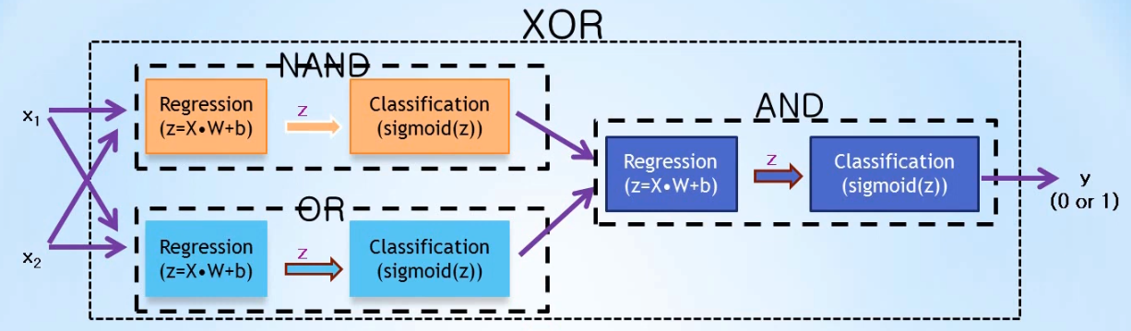
Multiple Layer Perceptron
XOR Problem can be solved with a combination of NAND, OR, and AND Gate.
There are two hidden layers, which means we can solve the XOR Problem with Multiple Layer Perceptron

Slide 11
Multiple Layer Perceptron
So, we can solve complex problems with Multiple Layer Perceptron, which has lots of hidden layers for learning.
The more hidden layers MLP has, the deeper it is; that is, Deep Learning.
Multiple Layer Perceptron: more than 1 hidden layer

Slide 12
Multiple Layer Perceptron
We need to minimize the error between results and answers: Back Propagation

Slide 13
Together 1
Let's go to A Neural Network Playground: https://playground.tensorflow.org/#activation=tanh&batchSize=10&dataset=circle&regDataset=reg-plane&learningRate=0.03&regularizationRate=0&noise=0&networkShape=4,2&seed=0.99005&showTestData=false&discretize=false&percTrainData=50&x=true&y=true&xTimesY=false&xSquared=false&ySquared=false&cosX=false&sinX=false&cosY=false&sinY=false&collectStats=false&problem=classification&initZero=false&hideText=false

Slide 14
구글의 플레이그라운드
사이트(https://playground.tensorflow.org)
텐서 플로우 플레이그라운드는 자바 스크립트로 작성된 웹 애플리케이션으로 웹 브라우저에서 실행
이 사이트에서는 사용자가 딥러닝 모델을 구성하고 여러 가지 매개 변수를 조정하면서 실험할 수 있는 기능을 제공한다.

Slide 15
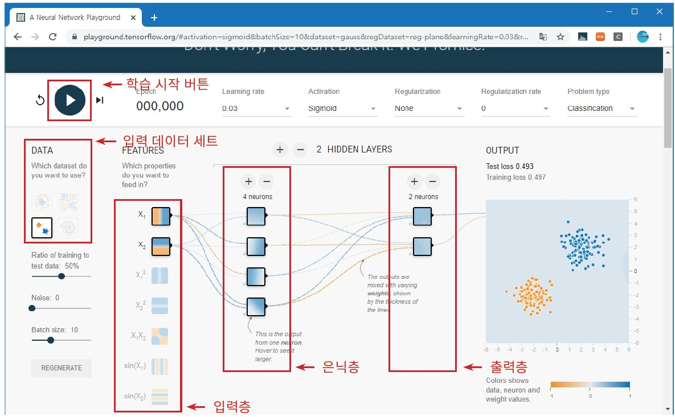
구글의 플레이그라운드

Slide 16
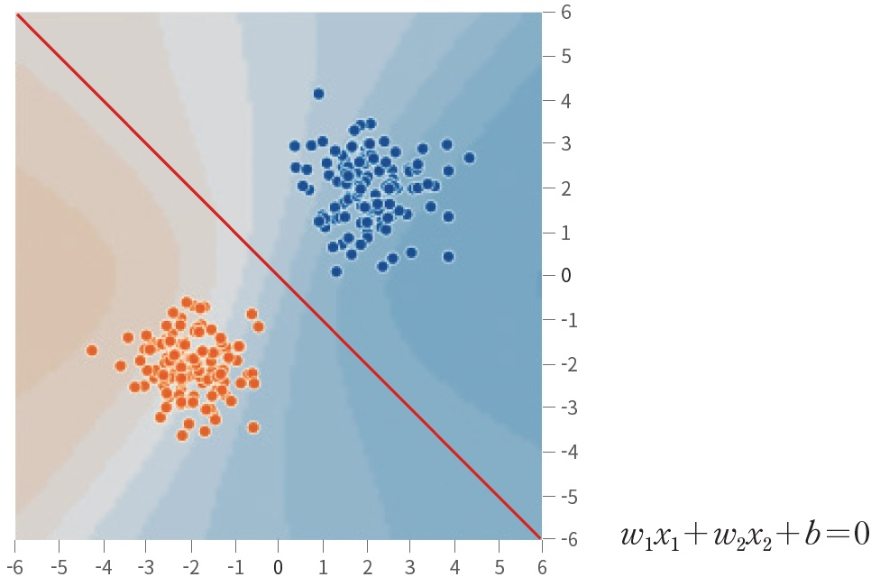
선형 분리 가능한 입력 데이터

Slide 17
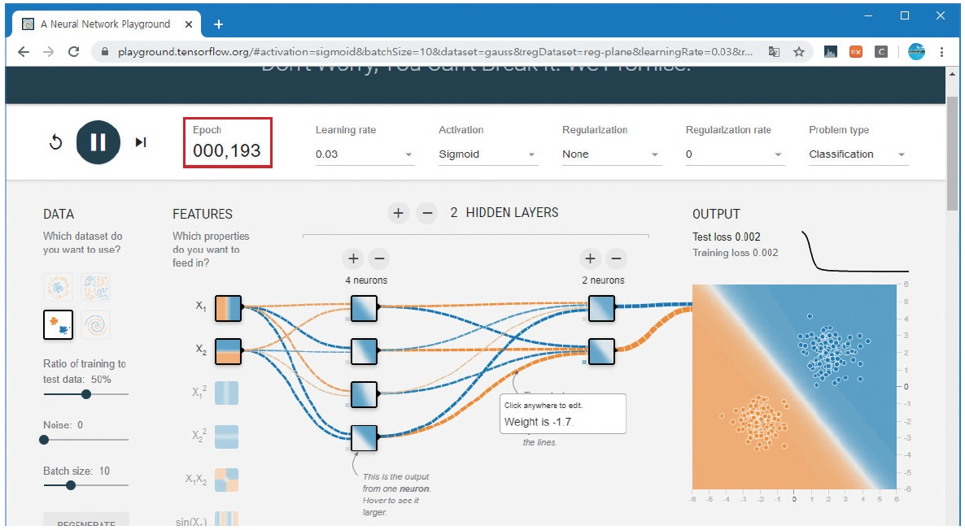
에포크

Slide 18
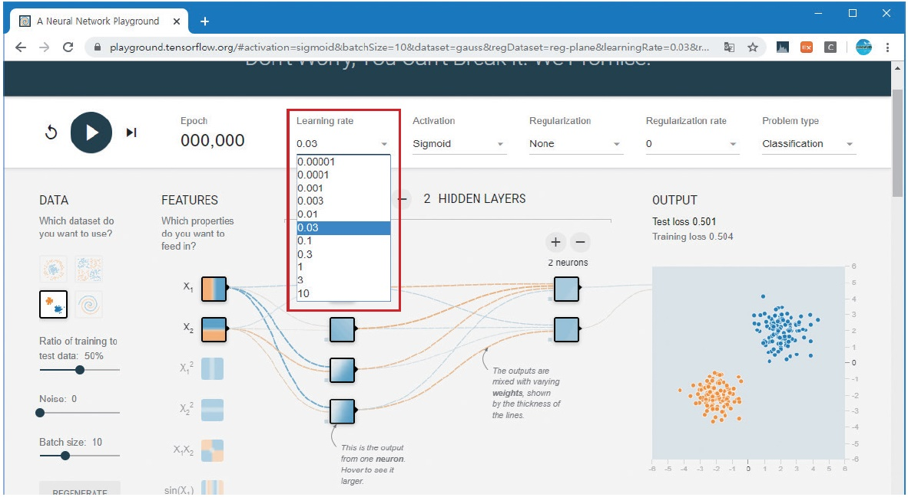
학습률

Slide 19
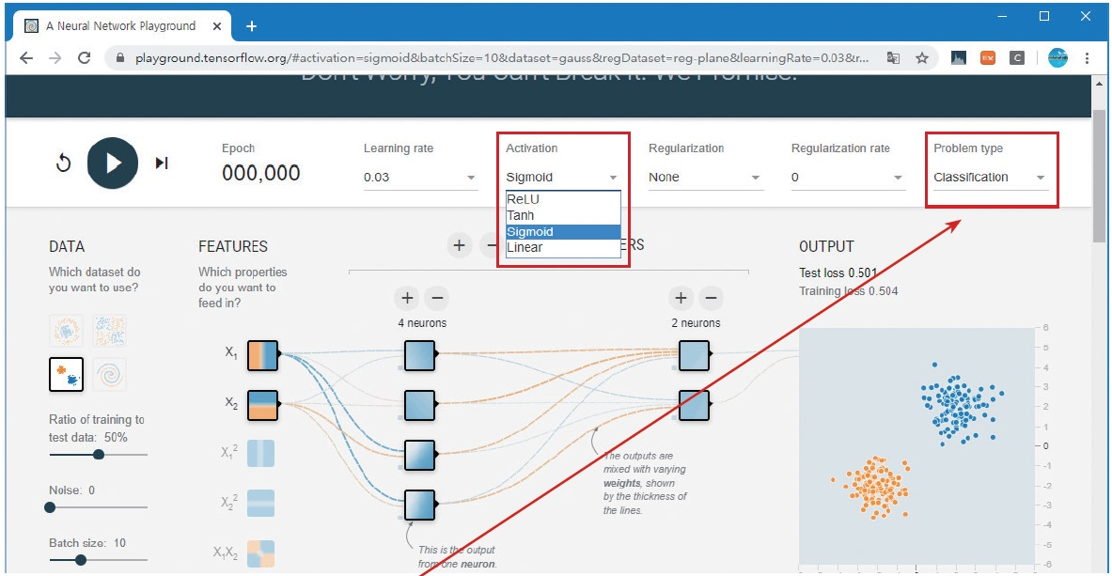
활성화 함수 선택

Slide 20
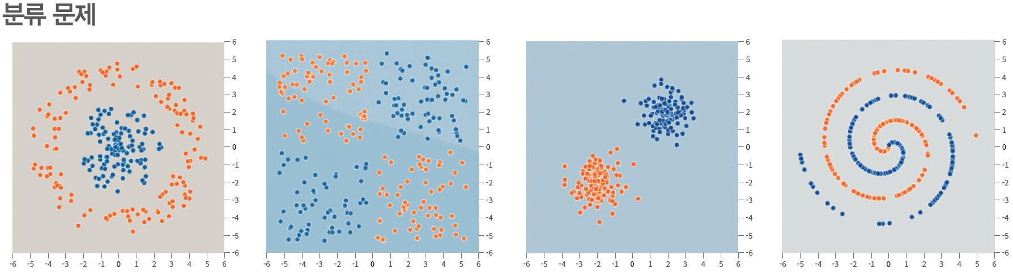
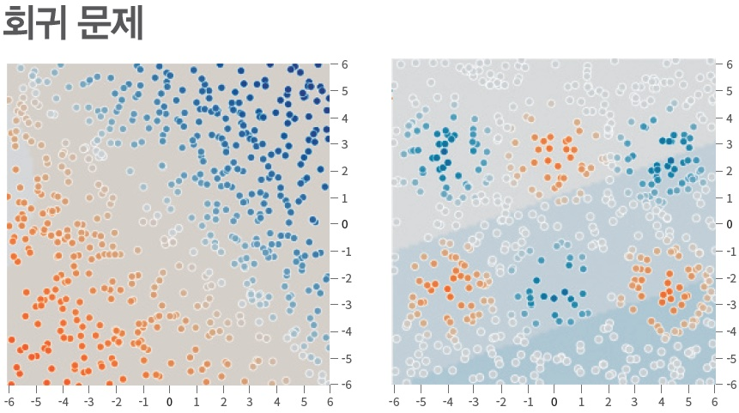
문제 유형

Slide 21
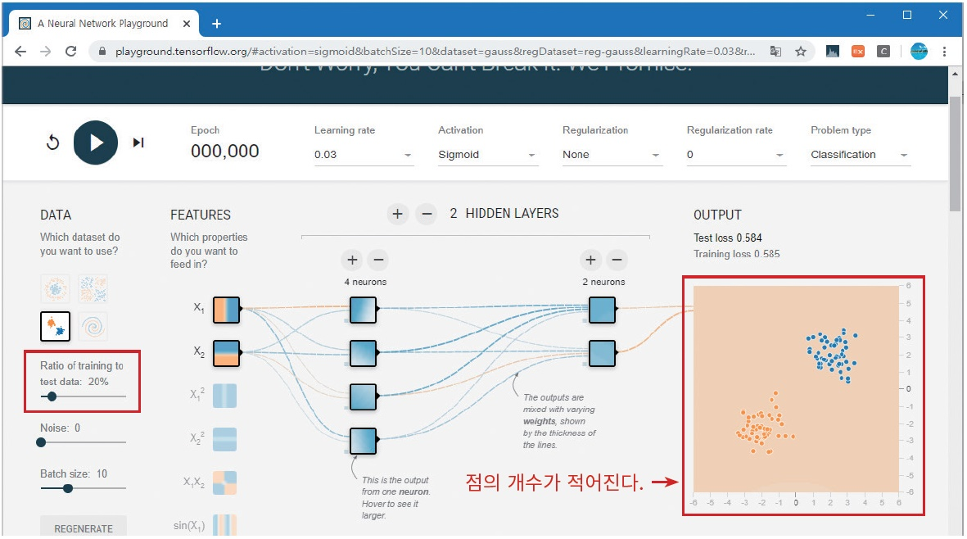
학습 데이터와 테스트 데이터의 비율

Slide 22
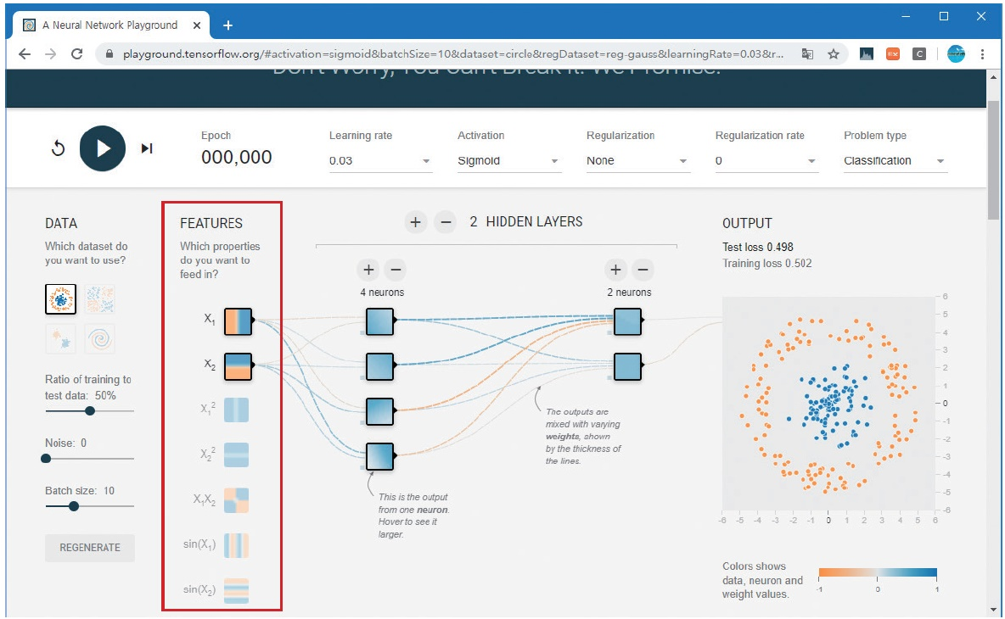
입력 특징 선택

Slide 23
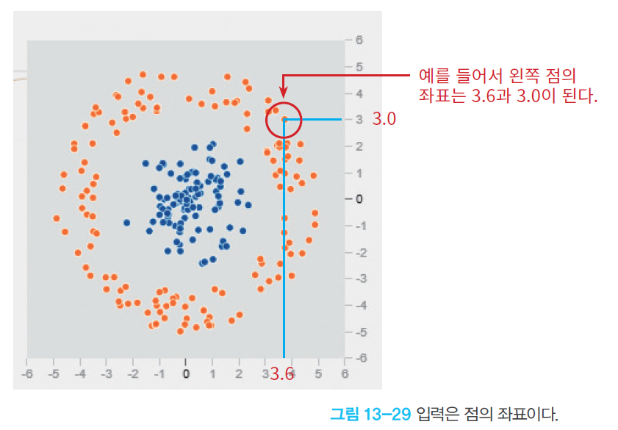
입력 특징

Slide 24
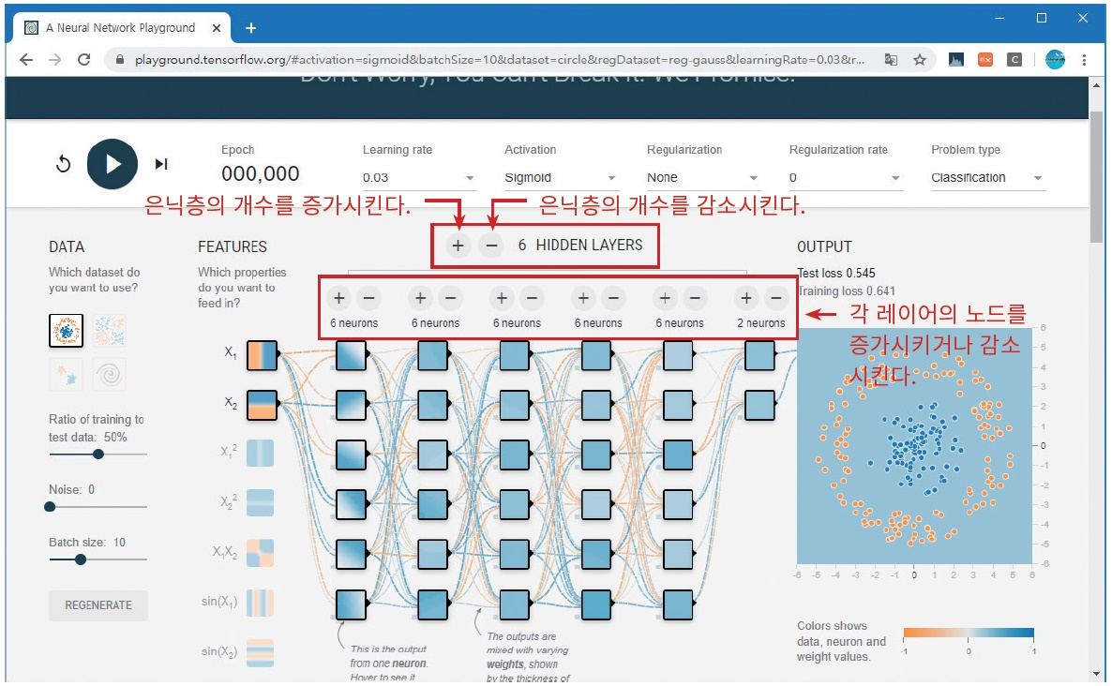
은닉층 추가하기

Slide 25
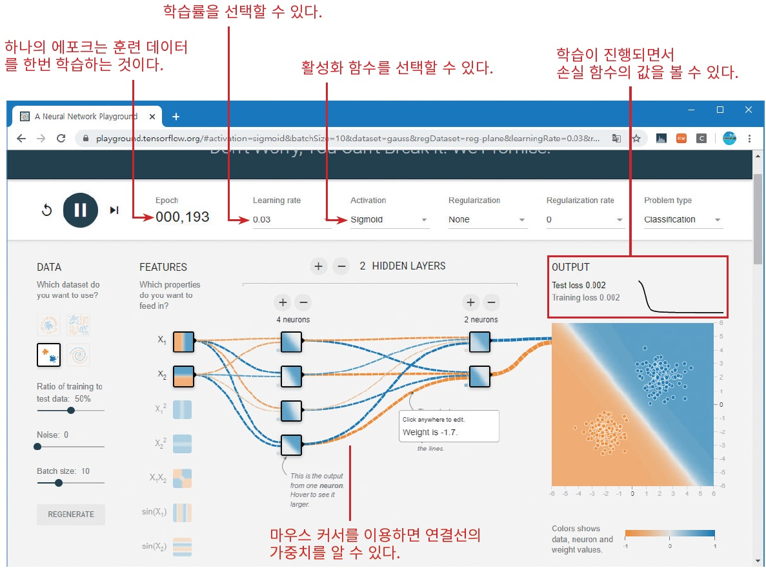
학습 시작

Slide 26
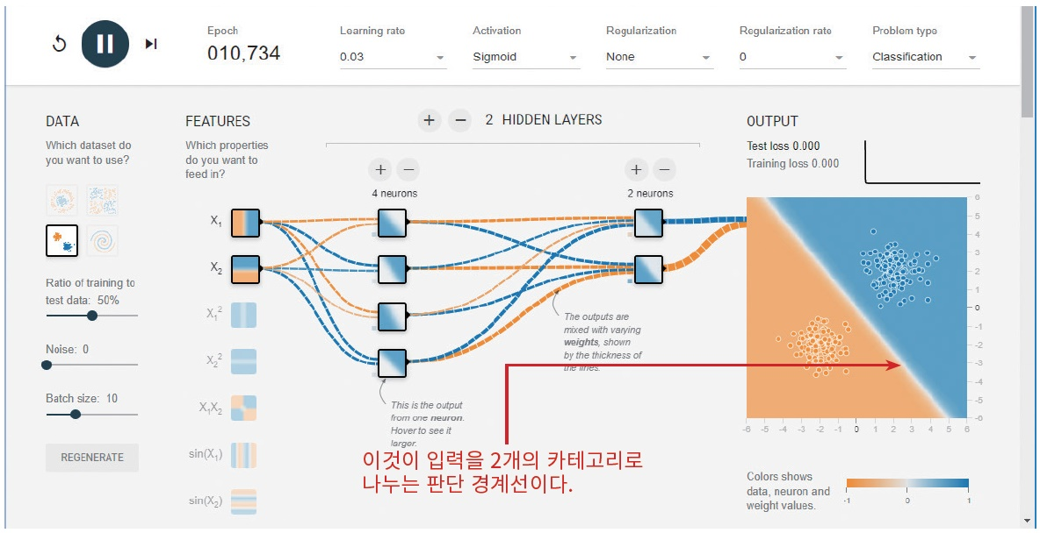
학습 완료

Slide 27
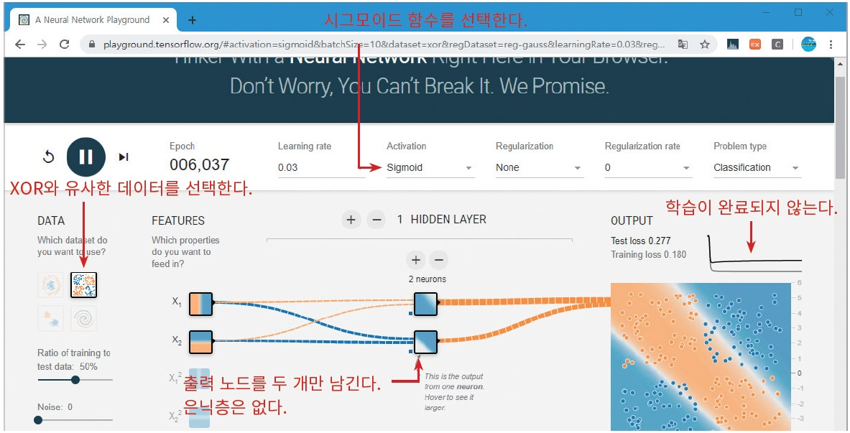
은닉층 없이 분류 실습

Slide 28
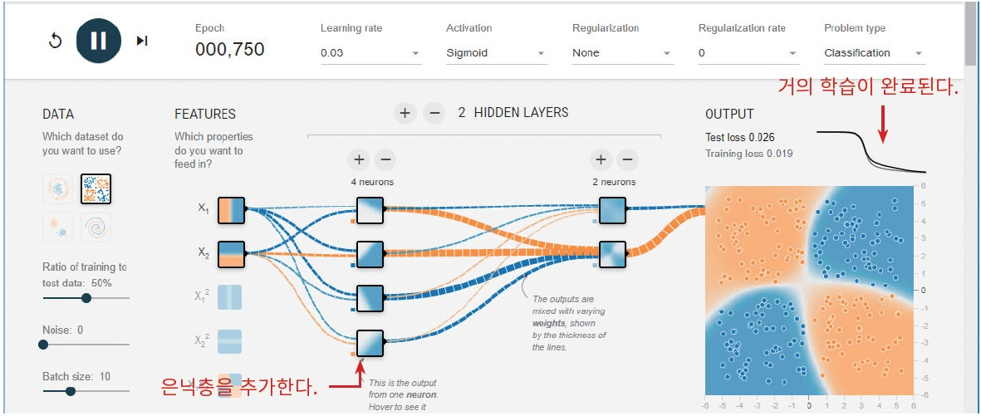
은닉층을 추가한 실습

Slide 29
Lab 1
make a neural network!
a
b
c

Slide 30
Together 2
Classification using sklearn.linear_model.Perceptron

Slide 31
Together 3
Classification using svm.
reference: https://www.kaggle.com/code/funxexcel/p1-sklearn-svm-model

Slide 32
Lab 1
MNIST datasets.
solution: https://www.kaggle.com/code/ismailelbouknify/deep-learning-with-sklearn-mlp-classifier/notebook

Slide 33
Lab 2
Heart disease classfication
solution: https://www.kaggle.com/code/cdabakoglu/heart-disease-classifications-machine-learning

Slide 34
THANKS
Do you have any questions?
youremail@freepik.com
+91 620 421 838
yourwebsite.com
Please keep this slide for attribution

